Slide 1
Arithmetic expressions & Conditional Branching

Slide 2
Objectives
♥ To be able to construct and evaluate expressions.
♥ To master operator precedence and associativity.
♥ To understand implicit type conversion and explicit type conversion.
♥ To master in Conditional and Branching Statements .

Slide 3
Introduction
An operator is a symbol that tells the computer to perform certain manipulations.
An expression is a sequence of operands and operators that reduces to a single value.

Slide 4
Classification depending on number of operands
Unary Operators- Having one operand. Examples are ++ and --.
Binary Operators- Having two operands. Examples are +, -, *, /, %, &&, || etc.
Ternary Operators- Having three operands. Example is ?:.

Slide 5
Arithmetic Operators
Operator | Meaning
+ | Addition or Unary Plus
- | Subtraction or Unary Minus
* | Multiplication Operator
/ | Division Operator
% | Modulus (remainder) Operator
Note
→ Integer division truncates remainder.
→ The % operator can’t be applied to a float or double.
→ The precedence of arithmetic operators:
Unary + or –
* / %
+ -

Slide 6
/* Objective- Enter the days and display no of months and remaining days */
#include<stdio.h>
int main()
{
int months,days;
Printf("Enter days \n”);
Scanf("%d”,&days);
months= days/30;
days= days%30;
printf("Months= %d \nDays= %d”,months,days);
Return 0;
}

Slide 7
Arithmatic Expression
An arithmetic expression is a combination of variables, constants, and operators.
For example,
a*b-c → a*b-c
(m+n)(x+y) → (m+n)*(x+y)
ax²+bx+c → a*x*x+b*x+c
Mathematical functions such as cos, sqrt, log, etc. are frequently used in analysis of real-life problems. We can include the header file math.h to use them in the beginning of the program. i.e. #include<math.h> then roots of quadratic equation can be calculated as-
x1= ( -b + sqrt ( b*b - 4*a*c ) ) / ( 2 * a )
x2= ( -b – sqrt ( b*b - 4*a*c ) ) / ( 2 * a )

Slide 8
Relational Operators
Used to compare values.
== Equal to (Equivalent to)
!= Not equal to
> Greater than
< Less than
>= Greater than or equal to
<= Less than or equal to

Slide 9
Relational expression
A relational expression yields a value of 1 or 0.
5 < 6 1
-34 + 8 > 23 - 5 0
if a=3, b=2, c =1; then a > b > c is 1
The associativity of relational operators is left to right.
The relational operators >, >= , < and <= have the same precedence. Just below them in precedence are the equality operators: = = and !=.

Slide 10
Logical Operators
Used to evaluate two or more expressions.
&& Logical AND (Result is true iff all expressions results in true)
|| Logical OR (Result is true if any expressions results in true)
! Logical NOT (Inverse the value, i.e. true into false and false into true)
Expressions connected by && or || are evaluated left to right, and evaluation stops as soon as the truth or falsehood of the result is known.

Slide 11
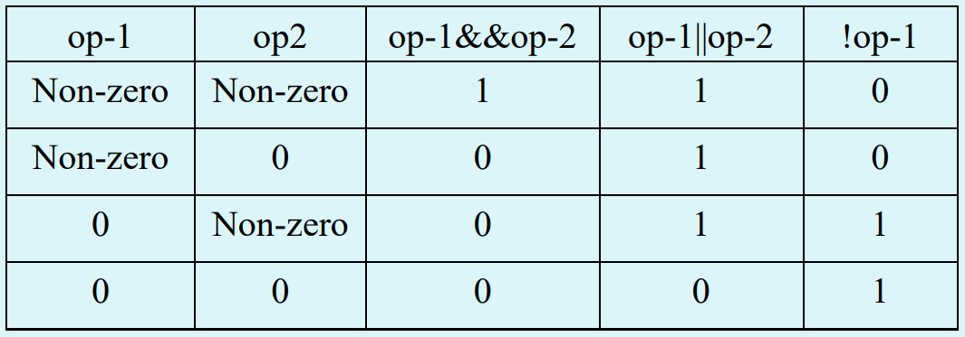
Truth Table

Slide 12
Logical Operators
The precedence of && is higher than that of ||, and both are lower than relational operators, so
To decide whether ch is an uppercase-
char ch;
ch >= ‘A’ && ch <= ‘Z’;
To decide whether a year is leap year-
year% 4 ==0 && year % 100 != 0 || year % 400 = = 0

Slide 13
Assignment Operators
= Simple Assignment, assign the value of RHS expression to LHS variable.
+= Add and assign for example a+=b evaluates in a=a+b.
-= Subtract and assign for example a-=b evaluates in a=a-b.
*= Multiply and assign for example a*=b evaluates in a=a*b.
/= Divide (Quotient) and assign for example a/=b evaluates in a=a/b.
%= Modulus (Remainder) and assign for example a%=b evaluates in a=a%b.

Slide 14
Increment and Decrement
++ (Increment operator) for example a++ evaluates in a=a+1.
-- (Decrement operator) for example a-- evaluates in a=a-1.
These can be further classified in two categories depending on their use.
Pre-increment / Pre-decrement- when used as ++a or --a. It means increase / decrease the values of operands before using them. For example: int a=10; printf(“%d”,++a); will print 11.
Post-increment / Post-decrement- when used as a++ or a--. It means increase / decrease the values of operands after using them. For example: int a=10; printf(“%d”,a++); will print 10 and then increase the value of a by 1.

Slide 15
Bitwise Operators
& Bitwise AND, performs AND operations on bits.
| Bitwise OR, performs OR operations on bits.
^ Bitwise XOR, performs XOR operations on bits.
~ Bitwise NOT, INVERSE the bits.
<< Left shift, Shift bits towards left upto n no of bits.
>> Right shift, Shift bits towards right upto n no of bits.

Slide 16
Special Operators
Sizeof It is a compile time operator which returns size of any object, variable or data type in no. of bytes.
& Address-of operator returns the memory address associated with operand.
* Pointer returns the value stored at given memory address.
-> Pointer to Member Provide access to the member of structure using pointer.
. (Dot) Provide access to the member of structure.
, (Comma) It separates expressions.

Slide 17
Conditional Operator
The Ternary Operator ?: is also known as conditional operator. It allow to execute different blocks of code based on specific conditions. These conditions are generally comparisons between variables and constants, evaluated as true or false.
CONDITION?TRUE_CASE:FALSE_CASE;

Slide 18
Condition?Code_if_true:Code_if_false;
condition: The condition that you want to evaluate. It is typically a comparison or a boolean expression that results in either true (non-zero) or false (zero).
expression_if_true: The expression that is executed if the condition is true.
expression_if_false: The expression that is executed if the condition is false.

Slide 19
/*** C program to check whether a number entered by user is even or odd using conditional operator */
#include<stdio.h>
int main()
{
int n;
printf(“\nEnter a no..\n”);
scanf(“%d”,&n);
n%2==0 ?printf(“\nEven”):printf(“\nOdd”);
return 0;
}

Slide 20
/** * C program to find maximum between 3 numbers using conditional operator */
#include <stdio.h>
int main()
{
int num1, num2, num3, max;
printf("Enter three numbers: ");
scanf("%d%d%d", &num1, &num2, &num3);
max = (num1 > num2 && num1 > num3) ? num1 : (num2 > num3) ? num2 : num3; printf("\nMaximum between %d, %d and %d = %d", num1, num2, num3, max);
return 0;
}

Slide 21
Check Leap Year
Leap year condition If a year is exactly divisible by 4 and not divisible by 100 then its Leap year. Else if year is exactly divisible 400 then its Leap year. Else its a Common year.

Slide 22
#include <stdio.h>
int main()
{
int year;
printf("Enter any year: ");
scanf("%d", &year);
(year%4==0 && year%100!=0) ? printf("LEAP YEAR") : (year%400 ==0 ) ? printf("LEAP YEAR") : printf("COMMON YEAR");
return 0;
}

Slide 23
Exercises
WAP that checks whether the two numbers entered by the user are equal or not.
WAP to take input 2 numbers from user and display the larger number.
WAP to find whether given 3 digit number is armstrong or not.
WAP to enter age and check whether a person can vote or not.

Slide 24
Assignment
WAP that accepts marks of five subjects and finds percentage and prints grades according to the following criteria using ternary operator:
Between 90-100%--------------Print ‘A’
80-90%----------------------------Print ‘B’
60-80%---------------------------Print ‘C’
Below 60%----------------------Print ‘D’

Slide 25
Type Conversions
Implicit Type Conversion
C permits mixing of constants and variables of different types in an expression. C automatically converts any intermediate values to the proper type so that the expression can be evaluated without loosing any significance. This automatic conversion is known as implicit type conversion.
The rule of type conversion: the lower type is automatically converted to the higher type.

Slide 26
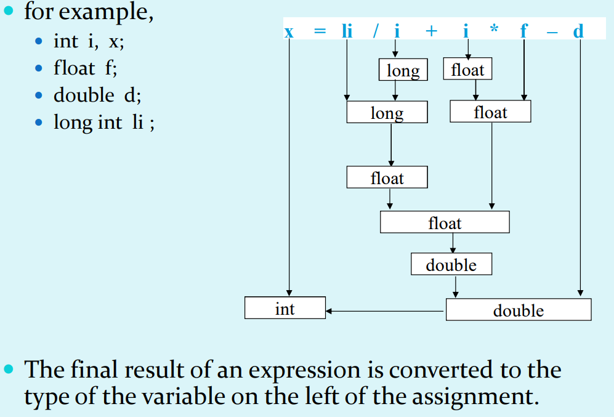

Slide 27
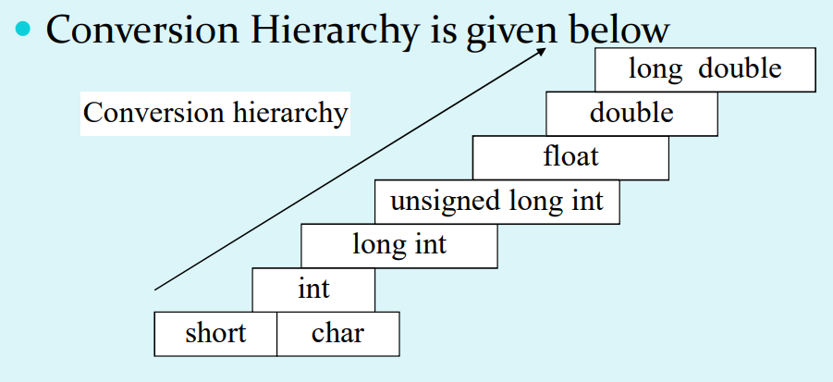
Conversion Hierarchy

Slide 28
Explicit conversion
We can force a type conversion. The general form of explicit conversion is
( type-name ) expression
for example:
x = ( int ) 7.5 ;
a = ( int ) 21.3 / (int) 4.5;
a = ( float ) 3 / 2 ;
a = float ( 3 / 2 ) ;

Slide 29
Operators Precedence and Associativity
The precedence of operators determines the order in which they are evaluated in an expression. Operators with higher precedence are evaluated first.
Associativity of operators refers to the direction (left to right or right to left) an expression is evaluated within a program. Operator associativity is used when two operators of the same precedence appear in an expression.

Slide 30
The table given in the next slide will list the order of precedence of operators in C with their associativity i.e. either left to right or right to left.
In the table the operators with the highest precedence appear at the top of the table, and those with the lowest appear at the bottom.

Slide 31
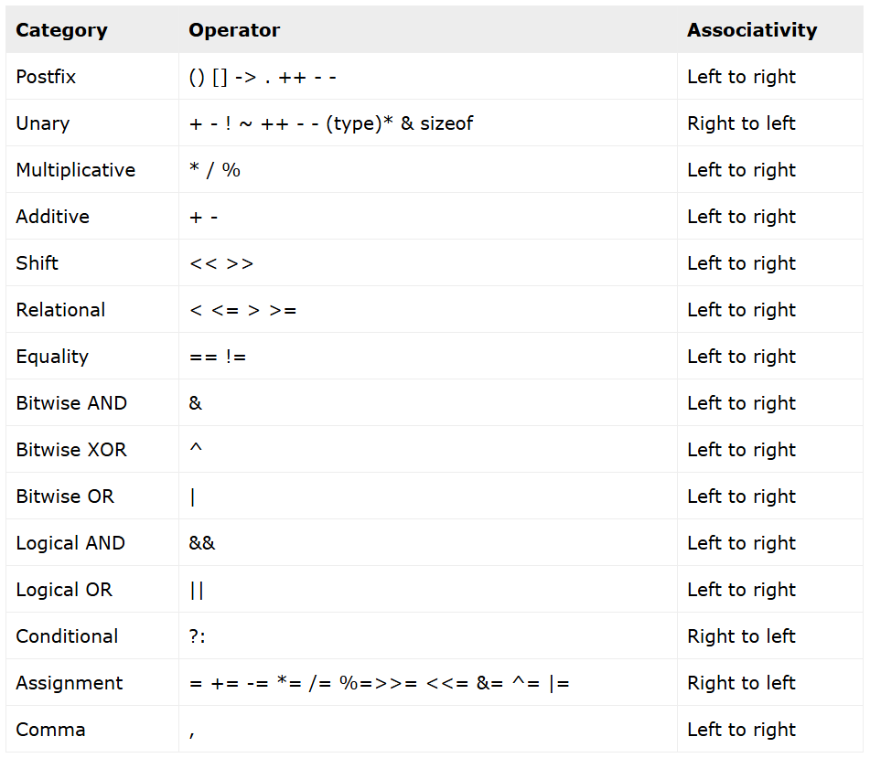

Slide 32
Conditional Statements

Slide 33
Boolean Expression
if Statement
if-else Statement
Ladder if else
switch case

Slide 34
Boolean expression
A C expression that evaluates either true or false is known as Boolean expression. However, in C programming there is no concept of true or false value.
In C we represent true with a non-zero integer and false with zero. Hence, in C if an expression evaluates to integer is considered as Boolean expression.

Slide 35
IF Statement
The if statement allows you to execute a block of code only if a specific condition is true.
if (condition) {
// Code to execute if the condition is true
}
condition: A boolean expression that evaluates to either true (non-zero) or false (zero).
The code inside the {} block runs only if the condition is true.

Slide 36
Curly braces {} are optional if there is only one statement after if. But it's good practice to always use {} to avoid bugs.
Simple if is Useful in Validating user input.
Checking conditions before performing operations (e.g., division by zero).

Slide 37
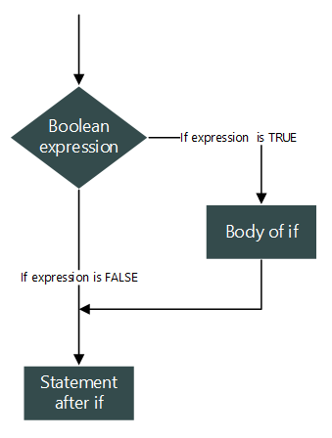
Flowchart of if statement

Slide 38
Examples
WAP that checks whether the two numbers entered by the user are equal or not.
WAP to take input 2 numbers from user and display the larger number.
WAP that finds whether a given number is even or odd.
WAP to check whether a person can vote or not.

Slide 39
Assignment
WAP that accepts marks of five subjects and finds percentage and prints grades according to the following criteria using simple if statement:
Between 90-100%--------------Print ‘A’
80-90%----------------------------Print ‘B’
60-80%---------------------------Print ‘C’
Below 60%----------------------Print ‘D’

Slide 40
Assignment
WAP to enter basic salary and age of a employee and calculate his/her gross salary on fallowing given conditions:
If age is greater or equals to 45 then the TA=40%, DA=30% and HRA=50% of the basic salary otherwise the company will provide TA=15%, DA=20% and HRA=25% of the basic salary.
Gross Salary= Basic Salary+TA+DA+HRA.

Slide 41
IF ELSE
An if...else statement in C is a control flow statement that allows you to execute different blocks of code depending on whether a condition is true or false.
Syntax
if (condition)
{
// Code to execute if condition is true
}
else
{
// Code to execute if condition is false
}

Slide 42
Examples
WAP that checks whether the two numbers entered by the user are equal or not.
WAP to take input 2 numbers from user and display the larger number.
WAP that finds whether a given number is even or odd.
WAP to check whether a person can vote or not.

Slide 43
Nested If Else
When an If Else statement kept inside another if else, it’s known as nesting and these structures known as Nested If Else.
There is no limit in nesting and it’s useful to test many conditions together.
If outer If’s condition is true, only then the control enters to inner if.
No limit for number of nesting.

Slide 44
Syntax
if(CONDITION)
{
if(CONDITION)
{
Statements when both if’s TRUE;
}
}
else
{
if(CONDITION)
{
Statements for another if;
}
else
{
Statements;
}
}

Slide 45
Ladder if else
A ladder if-else is a decision-making control structure where multiple conditions are checked one after another.
The first if is checked.
If true → its block runs, and the rest are skipped.
If false→ control moves to the next else if.
This continues until one condition is true or the final else executes.
It looks like a ladder because conditions are stacked.

Slide 46
Syntax
if (condition1)
{
// code if condition1 is true
}
else if (condition2)
{
// code if condition2 is true
}
else if (condition3)
{
// code if condition3 is true
}
else {
// code if none of the conditions are true
}

Slide 47
/***This example will display grade depending upon entered marks. If marks>=90 then grade A, If marks>=75 then B, Marks>=50 then C, fail otherwise */
#include<stdio.h>
int main() {
int marks;
printf("Enter your marks: ");
scanf("%d", &marks);
if (marks >= 90) {
printf("Grade: A\n");
}else if (marks >= 75)
{
printf("Grade: B\n");
}else if (marks >= 50)
{
printf("Grade: C\n");
}
else
{
printf("Grade: Fail\n");
}
return 0;
}

Slide 48
Switch Case
The switch case is a multi-way branch statement. It allows you to execute one block of code out of many, based on the value of an expression (usually an integer or character).
expression must be an int or char (not float/double/string).
case values must be constant literals.
break; is used to stop execution after a case.
If you omit break;, execution will “fall through” to the next case.
default is optional, and executes if no case matches.

Slide 49
Syntax
switch (expression) {
case value1:
// code to be executed if expression == value1
break;
case value2:
// code to be executed if expression == value2
break;
case value3:
// code to be executed if expression == value3
break;
...
default:
// code to be executed if no case matches
}

Slide 50
#include <stdio.h>
int main()
{ int day; printf("Enter day number (1-7): "); scanf("%d", &day);
switch(day) {
case 1:
printf("Sunday\n");break;
case 2:
printf("Monday\n");break;
case 3:
printf("Tuesday\n");break;
case 4:
printf("Wednesday\n");break;
case 5:
printf("Thursday\n");break;
case 6:
printf("Friday\n");break;
case 7:
printf("Saturday\n");break;
default: printf("Invalid day number!\n");
}
return 0;
}

Slide 51
Assignment 1
Write a C program to find maximum between two numbers.
Write a C program to find maximum between three numbers.
Write a C program to check whether a number is (-)ve, (+)ve or zero.
Write a C program to check whether a no is divisible by 5 and 11 or not.
Write a C program to check whether a number is even or odd.
Write a C program to check whether a year is leap year or not.
Write a C program to check a character is alphabet or not.
WAP to input any alphabet and check it is vowel or consonant.
Write a C program to input any character and check whether it is alphabet, digit or special character.
WAP to check whether a character is uppercase or lowercase alphabet.

Slide 52
Assignment 2
Write a C program to input week number and print week day.
Write a C program to input month number and print number of days in that month.
Write a C program to count total number of notes in given amount.
WAP to input angles of a triangle and check whether triangle is valid or not.
Write a C program to input all sides of a triangle and check whether triangle is valid or not.
Write a C program to check whether the triangle is equilateral, isosceles or scalene triangle.
Write a C program to find all roots of a quadratic equation.
Write a C program to calculate profit or loss.

Slide 53
Assignment 3
Write a C program to input marks of five subjects Physics, Chemistry, Biology, Mathematics and Computer. Calculate percentage and grade according to following conditions:
Percentage >= 90% : Grade A Percentage >= 80% : Grade B Percentage >= 70% : Grade C Percentage >= 60% : Grade D Percentage >= 40% : Grade E Percentage < 40% : Grade F

Slide 54
Assignment 4
Write a C program to input basic salary of an employee and calculate its Gross salary according to following: Basic Salary <= 10000 : HRA = 20%, DA = 80% Basic Salary <= 20000 : HRA = 25%, DA = 90% Basic Salary > 20000 : HRA = 30%, DA = 95%
Write a C program to input electricity unit charges and calculate total electricity bill according to the given condition: For first 50 units Rs. 0.50/unit For next 100 units Rs. 0.75/unit For next 100 units Rs. 1.20/unit For unit above 250 Rs. 1.50/unit An additional surcharge of 20% is added to the bill

Slide 55
Comments in C
Comments are the statements which skipped by the compiler during the compilation. They contains information about the line of code and very usefull in documentation. In C we can provide comments in 2 ways:
Single Line Comments which start with // symbol and continues till the end of same line.
Multi Line Comments which start with /* and continues till encounters the */ in many lines.

Slide 56
Comments in C
/*It is multiline comment
May vary till
Any number of lines */
#include<stdio.h>
int main() //main function
{ /* We can include comments anywhere in program */
printf(“Hello”); //printing Hello
Return 0; //Returning 0 from main
} //End of main

